Slide 2
Minor Project – II Facial Recognition Door Unlock
MEMBER’S NAME | ROLL NUMBER | SAP ID | BRANCH
RAJUL DUBEY | R171218081 | 500069424 | DEVOPS
SHRIYANSH KAUSHIK | R171218100 | 500067485 | DEVOPS
KARAN SHARMA | R171218117 | 500070100 | DEVOPS
DEVESH YADAV | R171218038 | 50006965 | DEVOPS
Under the guidance of
Mr. Pushpendra Rajput
Assistant Professor,Cybernetics Cluster
School of Computer Science

Slide 3
CONTENTS
Abstract
Introduction
Problem Statement
Motivation
Objective
Methodology
Hardware Requirements
Software Requirements
Project Description
Raspberry Pi requirements
References

Slide 4
Abstract
When it comes to securing the shield of our house - the door - we must wisely choose a lock that does not compromise safety. In this technologically advanced age, upgrading ourselves from traditional mechanical locks to smart locks has become crucial. Today's digital door locks can come in handy, as they offer excellent features that can help you enhance and customize the security of your home as per your needs. One of these unique advantages that come with modern locks is Face Recognition Technology.
Face recognition is an advanced feature in digital locks where people can easily unlock the door using their faces. All you need to do is position your face in front of the lock, following which the camera scans it to check if it matches correctly with the pre-stored faceprints and then unlocks the door for you.
The technicality behind the face recognition system is quite interesting, and so are its advantages. Let's take a closer look at the various benefits of using a quality access system such as the Hafele Re-Veal digital lock that offers the face recognition feature..

Slide 5
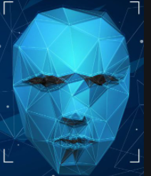
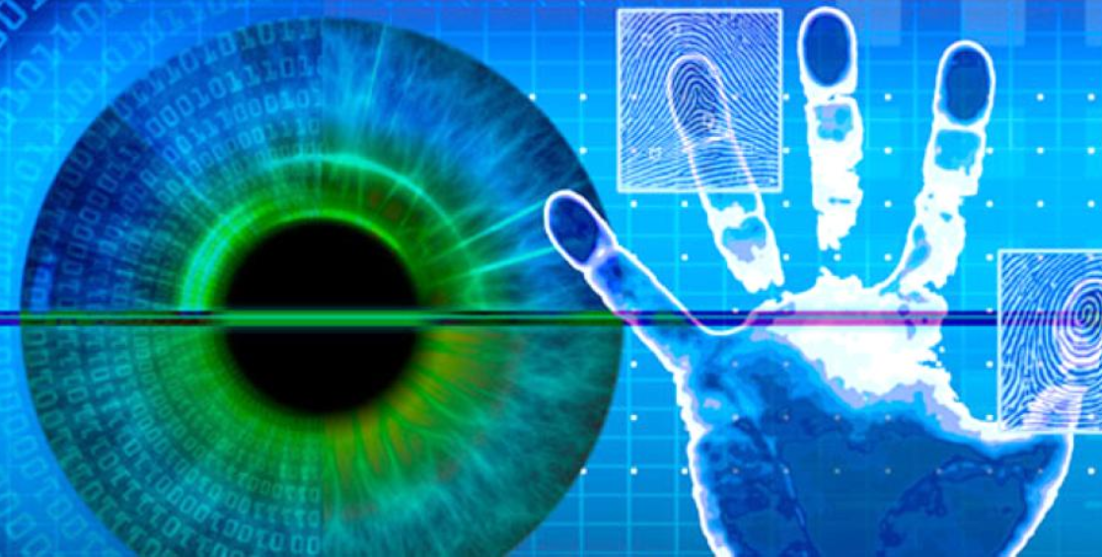
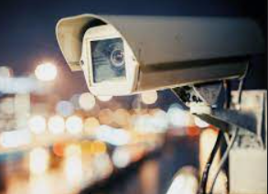
Introduction
The human’s face plays an important part in our social communication, conveying people’s identity. Using the person's face as a key to security, biometric face recognition technology has received significant attention in the past few years because of its potential for a vast variety of application in non-law enforcement and law enforcement.
Compared to other biometrics systems that use fingerprints / fingerprints and palmprint iris, facial recognition has different enhancements due to your non-abrasive process. Facial images can be taken remotely without touching the target person, and identification does not require contact with the person.
In addition, face recognition serves the purpose of crime prevention because recorded and archived photographs can later help identify a person.

Slide 6
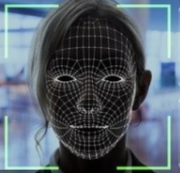
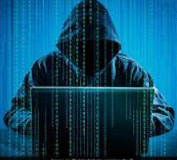
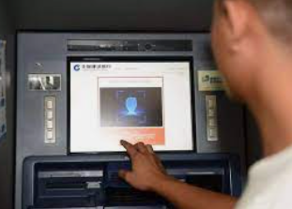
Introduction: USES
Personal Use
User Security
Criminal Identification
Facial recognition used to keep the log of security measures and office workers
Facial Recognition can be used to protect our belongings from other people
Facial recognition can be used to recognize criminal by their facial records

Slide 7
Problem Definition
To provide a efficient, stable and cost effective system that can be used at different levels of security for facial recognition on a commercial basis .
There are plenty of algorithms behind detecting a face from these pixels and further recognize the person in it and trying to explain them is beyond the scope of this tutorial, but since we are using the OpenCV library, which is incredibly simple to perform, face Recognition can be understood without getting deeper into the concepts.

Slide 8
Proposed Solution
To provide the solution for the above stated problem, we propose a system which use raspberry pi which is cost effective but a efficient solution for facial recognition.
Raspberry Pi will be accompanied by a bunch of hardware, accessories and software components like Python(Programming language), Haar-casCase(for face recognition) with the help of a camera which will be primary input for the system.
A face detection system has become very popular these days, as it can be very secure compared to fingerprint and typed passwords. You may have seen the face unlock feature in your smartphone which makes things very easy. Face detection is also used in many places such as airports, railway stations, and roads for surveillance.
By using OpenCV library, anyone can process images and videos to identify objects, faces, and even handwriting. When integrated with various libraries, such as NumPy & python, which is capable of processing the OpenCV array structure for analysis.

Slide 9
Motivation
Recent advancements in the field of information technology inspired us to make our daily life more and more digital and let us log about daily life so if something gets wrong we can quickly diagnose where was the problem
So in the field of the security there are lots of thief same alarm systems which are widely getting used these day but we’re still stuck on hundreds year old Lock and key system for locking our houses which sometimes lead us to vulnerable situations when some creates a duplicate key of your house so for to overcome this thread were working on facial recognition door unlock system which will help people to go anywhere without the tension of losing keys or a robbery .

Slide 10
Objective
The main objective of this project is to create a failsafe system for door which can lock and unlock the door by recognizing the face of the person
The system will also keep the log of people and report the user through an email or a message.
A face detection system has become very popular these days, as it can be very secure compared to fingerprint and typed passwords. You may have seen the face unlock feature in your smartphone which makes things very easy. Face detection is also used in many places such as airports, railway stations, and roads for surveillance.

Slide 11
Methodology
The program will be written in the python with OpenCV embedded.
Python was chosen for it’s ease of embedding OpenCV as well as it’s Ide being made available for the raspberry pi (processing device)
Here, we will build a Face Recognition system using the OpenCV Library on Raspberry Pi, as it is portable to work as a surveillance system. This system is tested by me and will surely work without any issue.

Slide 12
Methodology
The program has 3 Major codding parts
Capture the image
Take the video input from the webcam
Take the instance of video input as picture
Detect face
Convert image into grey
Use Haar-cascade pre-trained models with the use of OpenCV to detect the face
Match the faces from Database
PCA classifier will be used to recognize the face if it exists in the database
If the face matches then it will send signals to Pi relay throug GPIO pins which will driver the DC motors which will unlock the door.

Slide 13
Hardware Requirements
Raspberry pi: it will be used as processing machine for the input data from webcam with OpenCV and Haar-cascade
Webcam: Used to capture image
Testing machine: A testing environment will be used to test the code before deploying it to the host

Slide 14
Hardware Requirements
Stepper Motor: The stepper motor is used for precise
positioning with a motor. Speed of motor is
controlled by the frequency of the pulses.
Solenoid Lock: Solenoid lock denotes a latch for electrical locking and unlocking.
Miniature Door: A miniature door will be used to test the prototype for better configuration

Slide 15
Software Requirements
The Raspberry Pi needed to be installed with python 3 and OpenCV 2.4 to process the image.
The OpenCV contains the necessary classes for Haar casCade face recognition and the python IDE can be used for implementing the embedded code
Certain libraries were needed to be downloaded and installed separately for the system to function properly

Slide 16
Project Description
The basic idea was to develop a cost effective but efficient system for facial recognition door unlock system
We will use raspberry pi as the processing unit for the facial recognition system to unlock the door
A web camera will be used to take facial image as input for the system
If the face matches then it will send signals to Pi relay througg GPIO pins which will driver the DC motors which will unlock the door.

Slide 17
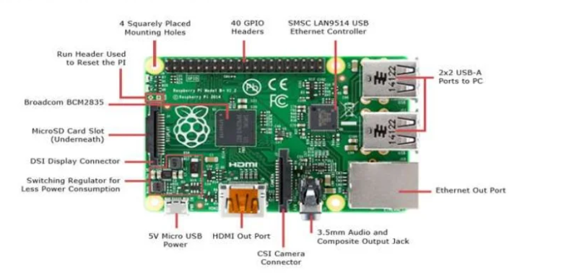
Hardware Requirements Raspberry Pi

Slide 18
References
http://www.Wikipedia.org
http://www.nec.com/en/global/solutions/biometrics/technologies/face_recognition.html
https://www.raspberrypi.org
https://www.python.org
https://www.elinux.org
https://www.raspbian.org/RaspbianELinux
https://reference wolfram.com/language/tutorial/EigenvaluesAnd Eigenvectors.html
https://learn.adafruit.com/raspberry-pi-face-recognition-treasurebox/overview

